Slide 1
OpenMP
Interakcija sa okruženjem
  Promenljive okruženja
  Runtime bibliotečke funkcije
Odredbe – (nastavak)

Slide 2
interakcija sa radnim okruženjem
OpenMP obezbeđuje nekoliko načina pomoću kojih programer može da interaguje sa radnim okruženjem bilo da bi dobio informacije od njega bilo da bi uticao na izvršenje programa.
Omp definiše interne upravljačke promenljive (internal control variables).
  Ovim promenljivim upravlja OMP implementacija.
  Ovim promenljivim se ne može direktno pristupati niti se mogu modifikovati na aplikativnom nivou;
    ove promenljive se mogu testirati i modifikovati preko omp funkcija i promenljivih okruženje.
Definisane su sledeće interne upravljačke promenljive:
  nthreads-var – pamti broj niti za izvršenje paralelnog regiona
  dyn-var – određuje da li će se dozvoliti dinamičko prilagođavanje broja niti kod izvršenja paralelnog regiona
  nest-var – definiše da li je dozvoljen ugnježđeni paralelizam
  def-sched-var - pamti implementaciono definisani način distribucije iteracija petlje po nitima

Slide 3
Da bi se predefinisale vrednosti internih upravljačkih promenljivih na raspolaganju su četiri promenljive okruženja definisane standardom koje se mogu postaviti pre izvršenja programa
Za ovu svrhu mogu se koristiti i bibliotečke funkcije.
  one predefinišu vrednosti postavljene preko promenljivih okruženja.
    Da bi ove funkcije mogle da se koriste u C/C++ programima neophodno je uključiti omp.h header fajl.

Slide 4
Promenljive okruženja
OMP_NUM_THREADS integer
  utiče na nthreads-var upravljačku promenljivu
    npr. setenv OMP_NUM_THREADS 8
OMP_DYNAMIC flag
  utiče na upravljačku promenljive dyn-var
    flag može imati vrednost true ili false
  pomoću ove promenljive se može dozvoliti ili onemogućiti sistemu da dinamički prilagođava broj niti koje će se koristiti za izvršenje paralelnih regiona.
    npr. setenv OMP_DYNAMIC TRUE
OPM_NEST flag
  utiče na promenljivu nest-var i omogućava da se dozvoli ili onemogući korišćenje ugnježđenog paralelizma
    npr. setenv OMP_NESTED TRUE
    standard specificira da je po definiciji ova promenljiva inicijalizovana na false
    Ako implementacija ne podržava ugnježđeni paralelizam, modifikacija interne upravljačke promenljive nest-var nema efekta.
OMP_SCHEDULE
  utiče na upravljačku promenljivu def-sched-var koja definiše podrazumevani način distribucije iteracija u paralelnim for petljama
    Npr. setenv OMP_SCHEDULE "guided, 4“
    setenv OMP_SCHEDULE "dynamic"

Slide 5
OpenMP bibliotečke funkcije
Funkcije koje se odnose na broj niti
  void omp_set_num_threads (int) –
    postavlja broj niti u timu koje će se koristiti u okviru budućeg paralelnog regiona.
    predefiniše broj niti postavljen promenljivom okruženja OMP_NUM_THREADS
  int omp_get_num_threads (void) –
    vraća broj niti koji se koristi u tekućem paralelnom regionu.
  int omp_get_max_threads (void)
    vraća koliko maksimalno niti može biti u paralelnom regionu.
  int omp_get_thread_num (void)
    vraća redni broj (identifikator) niti u timu

Slide 6
OpenMP bibliotečke funkcije
int omp_get_num_procs (void)
  vraća broj procesora koji je na raspolaganju programu
void omp_set_dynamic (int)
  omogućava dinamičko prilagođavanje broja niti kod izvršenja budućeg paralelnog regiona
int omp_get_dynamic (void)
  vraća TRUE ako je dozvoljeno dinamičko podešavanje broja niti, FALSE u protivnom
void omp_set_schedule (kind,chunksize)
    predefiniše vrednost OMP_SCHEDULE promenljive okruženja
int omp_in_parallel (void)
  vraća TRUE ako se pozove u okviru paralelnog regiona, u protivnom FALSE
void omp_set_nested (int)
  dozvoljava ili zabranjuje ugnježđeni paralelizam
    predefiniše vrednost promenljive okruženja OPM_NEST
int omp_get_nested (void)
  vraća TRUE ako je dozvoljen ugnježđeni paralelizam, u protivnom FALSE

Slide 7
OpenMP bibliotečke funkcije
  omp_get_wtime()
    vraća vreme u sec od nekog trenutka u prošlosti
  omp_get_wtick()
    vraća kolika je preciznost časovnika koji se koristi u funkciji omp_get_wtime().

Slide 8
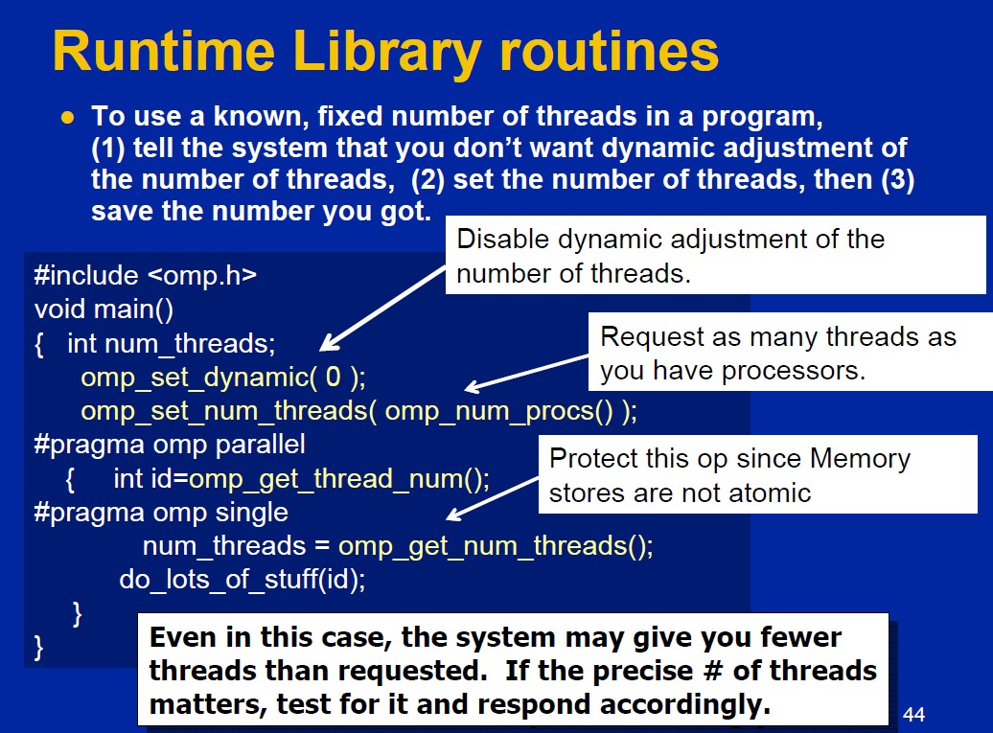

Slide 9
Još neke odredbe
if
num_threads
reduction
copyin

Slide 10
Odredba if
odredba
    if(skalarni_izraz)
određuje da li će parallel direktiva dovesti do kreiranja tima niti.
  Samo jedna if odredba može da se nađe u okviru parallel direktive
  ako je vrednost logičkog izraza false, onda se paralelni region izvršava samo od strane jedne niti (tj. sekvencijalno)

Slide 11
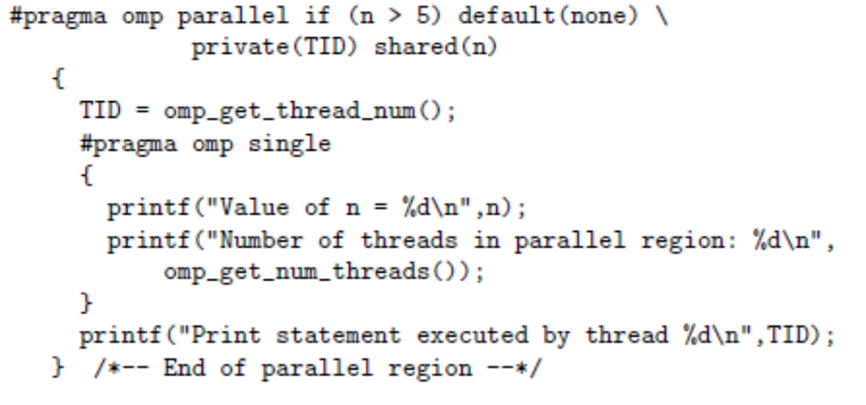
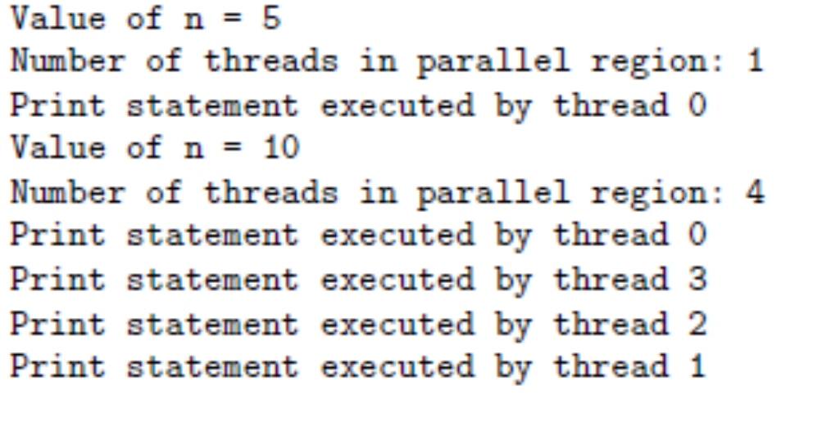
Primer
Izlaz iz programa za n=5 i n=10
funkcija omp_get_num_threads() - vraća broj niti u timu,
funkcija omp_get_thread_num() vraća redni broj niti (tj. identifikator niti).
Iskorišćena je direktiva #pragma omp single da bi se izbeglo izvršenje prve dve naredbe štampanja više puta.

Slide 12
Odredba num_threads
Omogućava da definišemo koliko niti će biti kreirano pri ulasku u paralelni region
Sintaksa
    num_threads (celobrojni_pozitivan_izraz)
Vrednost određena ovom odredbom redefiniše vrednost postavljenu pozivom bibliotečke funkcije omp_set_num_threads(),
  koja pak redefiniše vrednost broja niti postavljenu korišćenjem promenljive okruženja, koja pak redefiniše default broj određen implementacijom
U najvećem broju slučajeva se koristiti vrednost koja je određena implementacijom
Koristi se samo uz direktivu parallel!

Slide 13
Kako definisati koliki broj niti će biti u paralelnom regionu
Postoji više načinia
Po prioritetu:
  – IF odredba
  – NUM_THREADS odredba
  – omp_set_num_threads() bibliotečka funkcija
  – OMP_NUM_THREADS promenljiva okruženja
  – Default: zavisno od implementacije

Slide 14
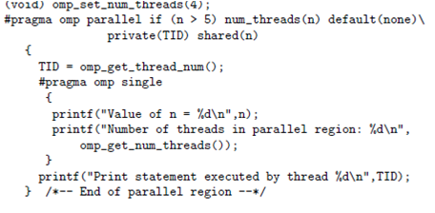
Primer
  primer ilustruje korišćenje odredbe num_threads i odredbe if
  Da bi ilustrovali prioritete pravila, ubačen je i poziv funkcije omp_set_num_threads kojom se broj niti postavlja na 4.
    Ovo se odredbom num_threads predefiniše.

Slide 15
Odredba reduction
Sintaksa
  reduction(operator:lista_promenljivih)
  Operetor može biti +,-, *, &&, ||, &, |, ^
Omogućava da se specificiraju neki oblici rekurentnog izračunavanja (u kojima se koriste komutativne i asocijativne operacije) tako da se ona mogu obaviti paralelno bez modifikacije koda.
  Programer mora da identifikuje operacije i promenljive koje će pamtiti rezultujuću vrednost.
  U tom slučaju se ostatak posla može prepustiti kompajleru.
    Rezultat će biti deljiv (shared) i nije neophodno eksplicitno deklarisati odgovarajuće promenljive kao shared.
    U opštem slučaju se preporučuje korišćenje ove odredbe umesto da se ova operacija obavlja manuelno.

Slide 16

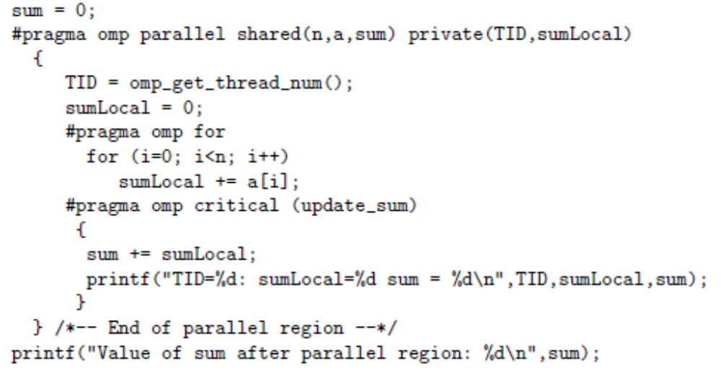
Primer sumiranje elemenata polja
sekvencijalno
Paralelni kod bez korišćenja reduction odredbe .
Zahteva korišćenje direktive critical da bi se ažurirala deljiva promenljiva sum

Slide 17
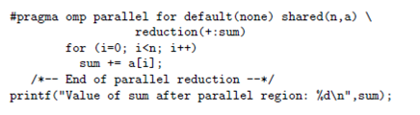
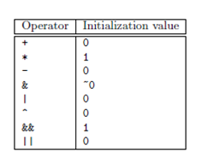
Sumiranje korišćenjem odrerdbe reduction
Promenljiva sum je privatana i inicijalizovana na 0 i deljiva promenljiva kojoj se pristupa uzajamno isključivo
NAD PROMENLJIVOM SUM NE SMEJU SE OBAVLJATI DRUGE OPERACIJE IZUZEV ONE KOJA JE U ODREDBI reduction navedena!
mogući operatori i inicijalne vrednosti promenljive koja je predmet redukcije

Slide 18
Threadprivate direktiva
Sintaksa
  #pragma omp threadprivate (lista)
Ova direktiva omogućava da promenljive navedene u listi budu lokalne za svaku nit i da se prostiru kroz više paralelnih regiona.
Ova direktiva mora se naći nakon deklaracije promenljivih koje su navedene u listi i pre obraćanja tim promenljivim
Na ulasku u prvi paralelni region, promenljive navedene u listi mogu biti nedefinisane ako se ne koristi COPYIN oderedba uz direktivu parallel.
Vrednosti koji su zapamćene u threadprivate promenljivim mogu se prostirati kroz više paralelnih regiona samo ako je broj niti konstantan.
  Zbog toga obavezno treba isključiti dinamičko kreiranje niti pozivom funkcije
    omp_set_dynamic(0)
Notes:
On first entry to a parallel region, data in THREADPRIVATE variables and common blocks should be assumed undefined, unless a COPYIN clause is specified in the PARALLEL directive
THREADPRIVATE variables differ from PRIVATE variables (discussed later) because they are able to persist between different parallel sections of a code.
Restrictions:
Data in THREADPRIVATE objects is guaranteed to persist only if the dynamic threads mechanism is "turned off" and the number of threads in different parallel regions remains constant. The default setting of dynamic threads is undefined.
The THREADPRIVATE directive must appear after every declaration of a thread private variable/common block.

Slide 19
Primer
#include <omp.h>
int a, b, i, tid; float x;
#pragma omp threadprivate(a, x)
main () {
/* Explicitly turn off dynamic threads */
omp_set_dynamic(0);
printf("1st Parallel Region:\n");
#pragma omp parallel private(b,tid)
{
tid = omp_get_thread_num();
a = tid;
b = tid;
x = 1.1 * tid +1.0;
printf("Thread %d: a,b,x= %d %d %f\n",tid,a,b,x);
} /* end of parallel section */
printf("************************************\n");
printf("Master thread doing serial work here\n"); printf("************************************\n");
printf("2nd Parallel Region:\n");
#pragma omp parallel private(tid)
{
tid = omp_get_thread_num();
printf("Thread %d: a,b,x= %d %d %f\n",tid,a,b,x);
} /* end of parallel section */
}
Output:
1st Parallel Region:
Thread 0: a,b,x= 0 0 1.000000 Thread 2: a,b,x= 2 2 3.200000 Thread 3: a,b,x= 3 3 4.300000 Thread 1: a,b,x= 1 1 2.100000 ************************************ Master thread doing serial work here ************************************ 2nd Parallel Region: Thread 0: a,b,x= 0 0 1.000000 Thread 3: a,b,x= 3 0 4.300000 Thread 1: a,b,x= 1 0 2.100000 Thread 2: a,b,x= 2 0 3.200000

Slide 20
Copyin odredba
Omogućava da se inicijalizuju vrednosti promenljivih navedenih u threadprivate direktivi na vrednosti tih promenljivih iz master niti (vrednosti tih promenljivih pre ulaska u prvi paralelni region)
Sintaksa
  copyin (lista_promenljivih)
  Promenljive koje se nalaze u listi_promenljivih moraju se prethodno pojaviti u odredbi threadprivate.
  Ova odredba se može koristiti uz direktive parallel, for i sections

Slide 21
Task direktiva - eksplicitni task paralelizam
Omogućava paralelizaciju iregularnih problema
  Beskonačne i while petlje
  Rekurzivne algoritme
  Producer/consumer problem
Task predstavlja nezavisnu jedinicu izvršenja
  Task se sastoji od
    Koda koji treba izvršiti
    Podataka (deljivih i privatnih)
  Niti izvršavaju različite taskove
    task može izvršti odma nakon kreiranja, ili
    Izvršenje taska može biti odloženo

Slide 22
Task direktiva
#pragma omp task [clause[[,]clause] ...]
structured-block
where clause can be one of:
if (expression) – ako je vrednost expression=false, task će odmah krenuti sa izvršenjem
untied
shared (list)
private (list)
firstprivate (list)
default( shared | none )
Notes:
Script:
The omp task construct should be placed inside a parallel region and the task should encapsulate a structured block. The syntax is #pragma omp task [clause[[,]clause] ...]
Explicit tasks are created in OpenMP following the same steps just described.
Thread encountering parallel construct creates a team of threads
at the omp task construct - a thread in team is assigned to one of the explicit tasks (and tied to it).
if the task construct is enclosed inside a while loop or other loop structure then each time the omp task construct is crossed a new instance of the task is created and assigned a thread – which can be initially differed or can be initially executed immediately
At the end of the parallel region their is an implied barrier - this barrier holds original master thread until all explicit tasks are finished.
The syntax is #pragma omp task [clause[[,]clause] ...]
Where clause can be one of the following clauses
if (expression) - a user directed optimization that weighs the cost of deferring the task versus executing the task code immediately. It can be used to control cache and memory affinity
Untied - specifies that the task created is untied. An untied task has no long term association with any given thread. Any thread not otherwise occupied is free to execute an untied task. The thread assigned to execute an untied task may only change at a "task scheduling point".
shared (list) a variable whose name provides access to the same block of storage
for each task region
private (list) a variable whose name provides access to a different block of storage
for each task region
firstprivate (list) variable whose name provides access to a different block of storage
for each task region and whose value is initialized with the value of the original variable
default( shared | none ) - specifies the default data scoping rules for the task
Now lets look at untied versus tied tasks
Background Info
see the openmp spec at www.openmp.org
or visit publib.boulder.ibm.com/infocenter at the url below to get at the definition and usage
http://publib.boulder.ibm.com/infocenter/lnxpcomp/v8v101/index.jsp?topic=/com.ibm.xlcpp8l.doc/compiler/ref/ruompplp.htm
The permissible clauses include:
if (expression) - a user directed optimization that weighs the cost of deferring the task versus executing the task code immediately. It can be used to control cache and memory affinity
When the if clause argument is false
The task is executed immediately by the encountering thread.
The data environment is still local to the new task...
...and it’s still a different task with respect to synchronization.
Its used to execute immediately (when exp is false) when the cost of deferring the task is too great compared to the cost of executing the task code – this can aid with cache and memory affinity
Untied – specifies that the task created is untied. An untied task has no long term association with any given thread. Any thread not otherwise occupied is free to execute an untied task. The thread assigned to execute an untied task may only change at a "task scheduling point". As opposed to a tied task which is a task that, when its task region is suspended, can be resumed only by the
same thread that suspended it; that is, the task is tied to that thread.
shared (list) with respect to a given set of task regions that bind to the same parallel
region, a variable whose name provides access to the same block of storage
for each task region
private (list) with respect to a given set of task regions that bind to the same parallel
region, a variable whose name provides access to a different block of storage
for each task region.
firstprivate (list) - a variable whose name provides access to a different block of storage
for each task region declares the scope of the data variables in list to be private to each thread. Each new private object is initialized with the value of the original variable as if there was an implied declaration within the statement block. Data variables in list are separated by commas.
default( shared | none ) – specifies the default data scoping rules fr the task
Description
tied task A task that, when its task region is suspended, can be resumed only by the
same thread that suspended it; that is, the task is tied to that thread.
untied A task that, when its task region is suspended, can be resumed by any thread
in the team; that is, the task is not tied to any thread.
firstprivate vars are firstprivate unless shared in the enclosing
Context - Specifies that each task should have its own instance of a variable, and that the value of each instance should be initialized to the value of the variable as it existed prior to the parallel directive
private With respect to a given set of task regions that bind to the same parallel
region, a variable whose name provides access to a different block of storage
for each task region.
shared With respect to a given set of task regions that bind to the same parallel
region, a variable whose name provides access to the same block of storage
for each task region.
A variable which is part of another variable (as an array or structure element)
cannot be shared independently of the other components, except for static data
members of C++ classes.
When a thread encounters a task construct, a task is generated from the code for the
associated structured block. The data environment of the task is created according to the
data-sharing attribute clauses on the task construct and any defaults that apply.
The encountering thread may immediately execute the task, or defer its execution. In the
latter case, any thread in the team may be assigned the task. Completion of the task can
be guaranteed using task synchronization constructs. A task construct may be nested
inside an outer task, but the task region of the inner task is not a part of the task
region of the outer task.
When an if clause is present on a task construct and the if clause expression
evaluates to false, the encountering thread must suspend the current task region and
begin execution of the generated task immediately, and the suspended task region may not be resumed until the generated task is completed. The task still behaves as a distinct
task region with respect to data environment, lock ownership, and synchronization
constructs. Note that the use of a variable in an if clause expression of a task
construct causes an implicit reference to the variable in all enclosing constructs.
A thread that encounters a task scheduling point within the task region may
temporarily suspend the task region. By default, a task is tied and its suspended task
region can only be resumed by the thread that started its execution. If the untied
clause is present on a task construct, any thread in the team can resume the task
region after a suspension.
The task construct includes a task scheduling point in the task region of its generating
task, immediately following the generation of the explicit task. Each explicit task
region includes a task scheduling point at its point of completion. An implementation
may add task scheduling points anywhere in untied task regions.

Slide 23
Tied & Untied Tasks
  Tied Tasks:
    tied task (vezani zadatak) kada se kreira dodeljuje mu se nit koja će ga izvršavati tokom celog životnog veka taska
    Podrazumevano je (default) da je task tied (tj. vezan)
  Untied Tasks:
    united task (nevezani zadatak) mogu izvršavati različite niti tokom životnog veka zadatka.
    untied task se kreira korišćenjem odredbe “untied”
    Primer: #pragma omp task untied
Notes:
Script:
By default, a task is created as a tied task. Meaning that it gets a thread assigned to the task for the life of the task. A tied task’s thread is the only thread that can service the task – however – since there can be many fewer threads than tasks – the runtime may suspend the assigned task (lets call it task Z) and assign the its thread go off for new duties (such as being assigned to new tasks – lets say task Y). When task Y’s execution reaches a scheduling point and when the runtime decides that it is time – the thread can by unassigned from task Yand given back task Z to resume computation.
So a thread may service multiple tasks – but each tied task can be service only by the thread originally assigned to it.
By contrast – An united task has no long term association with any given thread. Any thread not otherwise occupied is free to execute an untied task. The thread assigned to execute an untied task may only change at a "task scheduling point". There can be performance benefits from untied tasks in that the united task is more likely to get serviced by some idle thread sooner rather than later. On the other hand, especially on NUMA architecture, untied tasks could have a negative impact on performance if the random thread assigned to service my task is running on a remote processor with remote cache. It is recommended to avoid using untied tasks unless the developer if willing to explore these performance subtlies (actual performance difference may NOT be subtle but the concept underlying the issue may be subtle)
Now lets have a look at explicit tasks

Slide 24
Task direktiva – primer
  Tim niti se kreira na ulasku u omp parallel direktivu
  Jedna nit se odabira da izvrši while petlju, recimo nit “L”
  Nit L izvršava while petlju, kreira taskove, i pribavlja sledeće pointere u lančanoj listi.
  Svaki put kada nit L naiđe na omp task direktivu, ona kreira novi task i dodeljuje mu nit.
  Svaki task se izvršava u okviru svoje niti.
  Svi taskovi se moraju sinhronizovati na barijeri na kraju single direktive.
#pragma omp parallel
{
#pragma omp single
{ // block 1
node * p = head;
while (p) { //block 2
#pragma omp task
process(p);
p = p->next; //block 3
}
}
}
Notes:
Script:
This foil is one way to look at pointer chasing in a linked list, where the list must be traversed (and each node in the linked list) has to be processed by function “process”
Here we see the overview of the flow of this code snippet
A team of threads is created at the omp parallel construct
A single thread is chosen to execute the while loop – lets call this thread “L”
Thread L operates the while loop, creates tasks, and fetches next pointers
Each time L crosses the omp task construct it generates a new task and has a thread assigned to it
Each task runs in its own thread
All tasks complete at the barrier at the end of the parallel region

Slide 25
Mogući scenario izvršenja
Korišćenjem taskova mogu se paralelizovati while petlje i rekurzivni programi
Single Threaded
Thr1 Thr2 Thr3 Thr4
#pragma omp parallel
{
#pragma omp single
{ // block 1
node * p = head;
while (p) { //block 2
#pragma omp task
process(p);
p = p->next; //block 3
}
}
}
Block1 1
Block 1
Block 2
Task 1
Block3 3
Block 2
Task 1
Block3
Block 2
Task 2
Block3
Block 2
Task 3
Idle
Idle
Block 2
Task 2
Time
Block3
Time Saved
Block 2
Task 3
Notes:
Script:
Here is another look at the same example – but emphasizing the potential performance payoff from this sort of pipelined approach that we get from using tasks.
First off, observe that in single threaded mode, all tasks are done sequentially – Block1 is calculated ( node p is assigned to head), then block 2 (pointer p is processed by process(p), then block 3 ( reads next pointer in the linked list), then repeating Blocks2, block 3 etc.
1st animation
Now consider the same code executed in parallel
First, the master thread crosses the omp parallel construct and creates a team of threads.
Next one of those threads is chosen to execute the while loop – lets call this thread L
Thread L encounters an omp task construct at block 2 which copies the code and data for process(p) to a new task – well call it Task1
The thread L increments the pointer p – grabbing a new node from the list, and loops to the top of the while loop
Then thread L again encounters an omp task construct at block 2 which copies the code and data for process(p) to a new task – well call it Task2
The thread L increments the pointer p – grabbing a new node from the list, and loops to the top of the while loop
Then thread L again encounters an omp task construct at block 2 which copies the code and data for process(p) to a new task – well call it Task3
So Thread L’s job is simply to assign work to threads and traverse the linked list. The parallelism comes from the fact that thread L does not have to wait for the results of any task before generating a new task.
If the system has sufficient resources (enough cores, registers, memory, etc) then task1, task2, task3 can all be computed in parallel. So roughly speaking – the execution time will be about the duration of the longest executing task (task 2 in this case) plus some extra administration time for thread L. The time save can be significant compared to the serial execution of the same code. Obviously the more parallel resources that are supplied the better the parallelism – up until the point that the longest serial task begins to dominate the total execution time.

Slide 26
Gde se taskovi sinhronizuju (okončavaju izvršenje)?
Na implicitnim barijerama (na kraju paralelnog regiona, paralelne for petlje, single direktive)
  Na eksplicitnim barijerama, korišćenjem direktive: #pragma omp barrier
  Korišćenjem #pragma omp taskwait
Notes:
Script:
Now we are going to quickly explore when tasks are guaranteed to be complete. For doing computations with dependent tasks, where Task B specifically relies on completion of task A, it is sometimes necessary for developers to know explicitly when or where a task can be guaranteed to be completed.
This foil addresses this concern.
Tasks are guaranteed to be complete at the following three locations:
At thread or task barriers – such as the end of a parallel region, the end of a single region, the end of a parallel “for” region – we’ll talk more aout implicit thread or task barriers later
At the directive: #pragma omp barrier
At the directive: #pragma omp taskwait
In the case of #pragma omp taskwait Encountering task suspends at the point of the directive until all its children (all the encountering task’s children tasks created within the encountering task up to this point) are complete.
Only direct children - not descendants!
Similarly a Thread barrier (implicit or explicit) includes an implicit taskwait.
This pretty much wraps up the discussion of tasks – now we are going to look at data environment topics such as data scoping.

Slide 27
Primer okončanja zadataka
#pragma omp parallel
{
  #pragma omp task
  foo();
  #pragma omp barrier
  #pragma omp single
  {
    #pragma omp task
    bar();
  }
}
Multiple foo tasks created here – one for each thread
All foo tasks guaranteed to be completed here
One bar task created here
bar task guaranteed to be completed here
Notes:
Script:
Lets take a look at an example that demonstrates where tasks are guaranteed to be complete.
In this example, the master thread crosses the parallel construct and a team of N threads is created.
Each thread in the team is assigned a task – in this case each thread gets assigned a “foo” task – so that there are now N foo tasks created
The “exit” of the omp barrier construct is where we are guaranteed all the N of the foo tasks are complete.
Next a single thread crosses the omp task construct and a single task is created to execute the “bar” function.
The bar function is guaranteed to be completed at the exit of the single construct’s code block – the right curly brace that signifies the end of the single region

Slide 28
Zadatak
Napisati program koji štampa “A race car” ili “A car race” i maksimizira paralelizam

Slide 29
Primer 1/1 sekvencijalni kod
#include <stdlib.h> #include <stdio.h>
int main(int argc, char *argv[]) { printf("A "); printf("race "); printf("car "); printf("\n"); return(0); }
A race car
Šta će ovaj program odštampati ?

Slide 30
Primer 1/2
#include <stdlib.h> #include <stdio.h>
int main(int argc, char *argv[]) {
#pragma omp parallel
{
printf("A ");
printf("race ");
printf("car ");
} // End of parallel region
printf("\n"); return(0);
Šat će program odštampati ako je broj niti 2 ?
}

Slide 31
$ cc -xopenmp -fast hello.c
$ export OMP_NUM_THREADS=2
$ ./a.out
A race car A race car
“A A race race car car” ili
“A race A car race car”, ili
“A race A race car car”, ili
.....

Slide 32
Primer 1/3
#include <stdlib. #include <stdio.h
int main(int argc, char *argv[])
{
#pragma omp parallel
{
#pragma omp single
{
printf("A ");
printf("race ");
printf("car ");
}
} // End of parallel region
printf("\n"); return(0);
}
Šta će ovaj program odštampati ako se kreiraju 2 niti ?

Slide 33
Primer 1/3
$ cc -xopenmp –fast hello.c
$ export OMP_NUM_THREADS=2
$ ./a.out A race car
Ali samo jedna nit obavlja posao.......

Slide 34
Primer 1/4
int main(int argc, char *argv[]) {
#pragma omp parallel
{
#pragma omp single
{
printf(“A “);
#pragma omp task
{printf("race ");}
#pragma omp task
{printf("car ");}
}
} // End of parallel region
printf("\n"); return(0);
}
Šta će ovaj program odštampati ako se kreiraju 2 niti ?

Slide 35
Primer 1/5
$ cc -xopenmp -fast hello.c
$ export OMP_NUM_THREADS=2
$ ./a.out A race car
$ ./a.out A race car
$ ./a.out A car race
$
Zadaci se mogu izvršavati u proizvoljnom redosledu

Slide 36
Primer 2/1 hoćemo da se rečenica završava sa “is fan to watch”
int main(int argc, char *argv[]) {
#pragma omp parallel
{
#pragma omp single
{
printf(“A “);
#pragma omp task
{printf("race ");}
#pragma omp task
{printf("car ");}
printf(“is fun to watch “);
}
} // End of parallel region
printf("\n"); return(0);
}
Šta će ovaj program odštampati ako se kreiraju 2 niti ?

Slide 37
$ cc -xopenmp -fast hello.c
$ export OMP_NUM_THREADS=2
$ ./a.out
A is fun to watch race car
$ ./a.out
A is fun to watch race car
$ ./a.out
A is fun to watch car race
$

Slide 38
#pragma omp parallel
{
#pragma omp single
{
printf(“A “);
#pragma omp task
{printf("car ");}
#pragma omp task
{printf("race ");}
#pragma omp taskwait printf(“is fun to watch “);
}
} // End of parallel region
printf("\n");return(0);
}
Šta će ovaj program odštampati ako se kreiraju 2 niti ?

Slide 39
$ cc -xopenmp -fast hello.c
$ export OMP_NUM_THREADS=2
$ ./a.out
$
A car race is fun to watch
$ ./a.out
A car race is fun to watch
$ ./a.out
A race car is fun to watch
$
Prvo se izvršavaju zadaci jer smo postavili taskwait direktivu

